Slide 1
‘eXpert Management’
Craig Machon (Strategic Management Role)
James McHugh (Technical/Realisation Role)
Jonathan Pankethman (Finance Role)
Jon Townend (Marketing Role)

Slide 2
Who Are We?
'eXpert Management'
Set of young ambitious ventures – willing to learn and thrive on challenges
Variety of new ideas and skills
Operated in the Venture Matrix world for 2 years – vast knowledge and experience
Past experience on:
- design
- marketing (traditional & electronic)
- working with numbers
- listening to instructions
- leading other ventures
- problem solving
- working as a team
- willing to do more than the ordinary
- adaptability
- flexibility
- many more!

Slide 3
Project - Employability Questionnaire
Tasks – what we did!
Develop an effective questionnaire
- develop understanding of student perspectives on career skills
- research on different methods of questionnaire
- layout, presentation & structure
- distribution with venture working for us
Analysis of results
- identify trends, patterns and produce graphs, charts & statistic outcomes
- predict future forecast results
- produce action points from results to create future positives in students perspectives
- use of Microsoft Word, SurveyMonkey & Microsoft Excel
PowerPoint presentation at the Conference
- present our findings to tutors
- show charts, graphs and the method we did to complete it
- extra optional work that we accepted to do - determination and willing to work to improve

Slide 4
Feedback From Ventures
"successfully employed in developing appropriate survey" - Anne Nortcliffe (Employability Questionnaire)
"detailed analysis of the results, providing a valuable resource of social background" - Anne Nortcliffe (Employability Questionnaire)
"conducted them-selves in a professional and organised manner" - Anne Nortcliffe (Employability Questionnaire)
"demonstrating excellent communication skills" - Anne Nortcliffe (Employability Questionnaire)
"I would willing employ their service again in the future, as provided effectively managed this research project" - Anne Nortcliffe (Employability Questionnaire)
"brilliant" - Simon Brown
"progressive on arranging group meetings and negotiate goals and deadlines" - Lufei Li
"very professional" - Lufei Li
"a pleasure working with eXpertmanagement" - Lufei Li

Slide 5
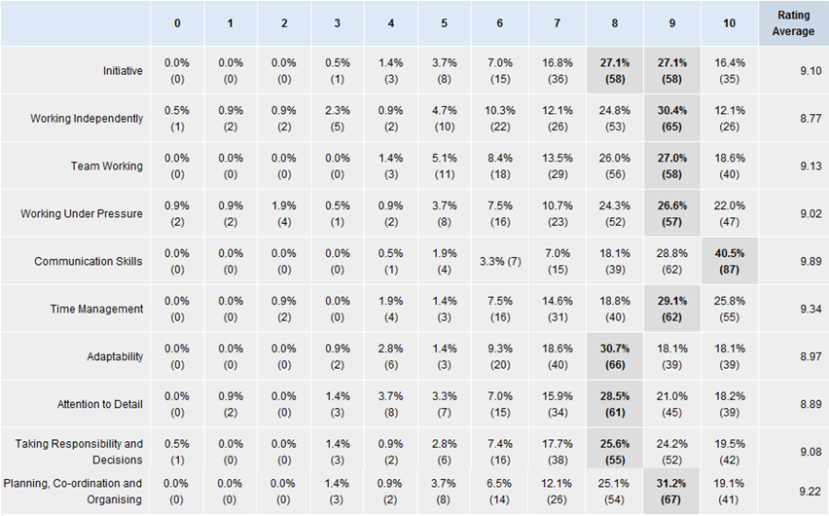
Overall Of Results
Notes:
KEEP THESE NOTES:
The table above shows overall what students highlighted as the main skills employers wanted to see, it clearly shows above that communication skills are valued the most with over 40% of people rating it 10/10.

Slide 6
Results
The questionnaire we designed allowed for many possibilities of evaluation and the first way choose was through Socio-Economic class beginning with the top group of the social-economic – managerial.
The most valued skills were communication skills and time management with 58% and 26% respectively and comparing that to the students who ticked that their parents were currently unemployed the skills most picked was taking responsibility and communication skills with 28% and 43% respectively.
The socio-economic most represented on our questionnaire was students ticking the professional i.e. Teacher/doctor parental job with 58/215 answering to this, the skills most popular for this was Initiative, Communication Skills and Attention to detail with 27%, 44% and 29% respectively. There is a clear link between all three with students recognising communication skills to be the most important attribute to have.

Slide 7
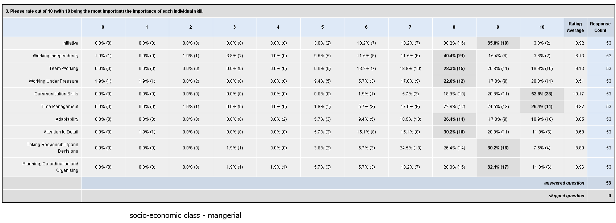
Results
This is the analysis for specifically students whose parents are included in the professional socio-economic group.

Slide 8
Results
Further analysis of the results was to look at the question
"Would you class yourself being Proactive or Reactive?"
Students could only pick 1 option and the results were very interesting.
Firstly looking at the students who picked proactive - they were hands on and practical the skill least valued was Taking Responsibility and Decisions with 24% compared to the 40% picking Communication Skills.
Students selecting the option of being reactive - so slightly spontaneous
i.e. students more likely to do the work the night before 27% choose Adaptability as their least importance skill with 38% choosing Communication skills.

Slide 9
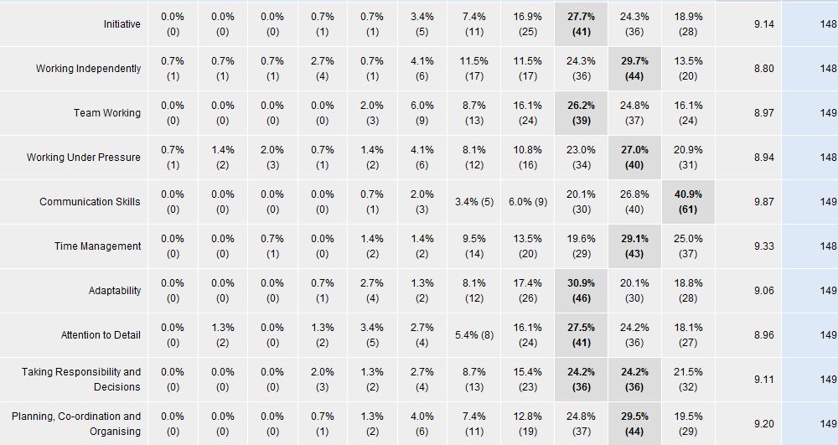
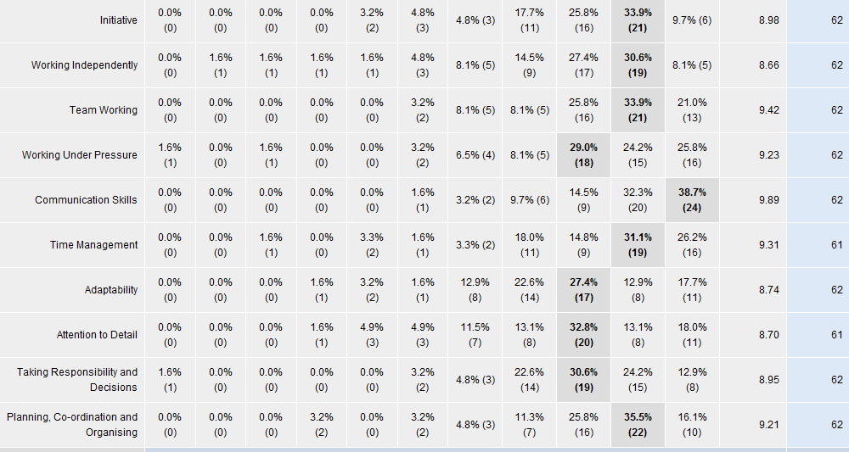
Results
The top graph represents Proactive results and the bottom graph represents Reactive results.

Slide 10
Employability Questionnaire
What We Have Learnt From The Questionnaire?
Communication skills
Time Management skills
Critical Analysis experience
Questionnaire skills & distribution
Integrated relationship
Planning skills
Adaptability
Working with numbers
Listening to instructions
Leadership skills
Innovation and creation of new ideas and methods

Slide 11
What was the purpose of the survey?
The purpose was to gain an insight into students opinions on employability skills
The aim was to see if there was any gaps that required attention within the education of the students
The way that we found these was to produce a short survey for students to fill in, this proved successful

Slide 12
What have we learnt as a group?
We learnt that being prepared was the key to our success. i.e. weekly progress meetings with Anne
No challenge is too big when you have a strong team
It is easy to get help when required, if the group is portrayed professionally i.e. Simon Clark helping us to advertise

Slide 13
How will these results help?
Develop teaching aids
Help change students perceptions
Inform lecturers where they be missing out in teaching
Develop new strategies; focus on low average scores to increase grades
Faculties will be able to use them for guidance on their own students opinions
Increase employability of the students

Slide 14
Thank you for Listening
Questions are welcomed

