Slide 1
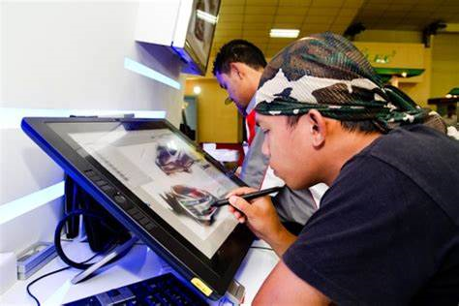
Careers in Creative Arts

Slide 2
Skills developed in the creative arts
ability to work independently
focus & self-discipline
the ability to receive feedback and learn from it
self-awareness
creativity and flexibility
innovation
an entrepreneurial mindset
resilience.
ability to work through problems
curiosity (also known as a questioning mindset)
imagination and vision
original thinking
Notes:
Source: www.prospects.ac.uk

Slide 3
Examples of careers related to the creative arts
Jobs directly related to your subject include:
Game designer
Special effects technician
Concept artist
Production set designer, theatre/television/film
Fine artist
Multimedia specialist
Textile designer
Jobs where your subject would be useful include:
Furniture conservator/restorer
Marketing & Advertising executive
Event manager
Copywriter
Museum/gallery curator
Community arts worker
Arts administrator
Museum education officer
Notes:
Source: https://www.prospects.ac.uk/careers-advice/what-can-i-do-with-my-degree
Also use: https://targetjobs.co.uk/careers-advice/career-planning/1040725-creative-careers-for-graduates

Slide 4
Labour Market Information
There are expected to be 900,000 new jobs in the sector by 2030. While other industries are at risk of their jobs being replaced by automation, the creative industries are relatively secure with a huge 87% of creative jobs at low or no risk of automation.
Places where you could work- Creativity is an important element of many careers ranging from engineering and consulting to marketing and publishing, to work in Museums, galleries and heritage sites, such as stately homes and cathedrals
So if you want to use your creativity in your job there are plenty of options open to you.
Notes:
When we think of jobs that involve creativity, certain images spring to mind: an artist wearing a smock splashed with paint; a ceramicist carefully shaping a spinning clay pot.
However -The creative arts is the fastest growing sector in the economy.
Employment in the creative industries grew by 30.6% between 2011 and 2018.
There are more people working in the creative industries than in financial services. Jobs in the creative industries are more future-proof than in other sectors
Source:. https://discovercreative.careers/students-and-parents/are-there-any-proper-jobs/

Slide 5
Examples of Higher Education courses related to the creative arts
Media Make Up with Special Effects- Bradford College
Animation BSc (Hons) - University of Bradford
Creative Advertising - Leeds Arts University
Creative Media Technology - Leeds Beckett University
Fashion and Textiles - University Centre Leeds, Leeds City College
Creative Practice: Graphic Design – Sheffield College
Comic and Concept Art - Leeds Arts University
Notes:
All found on ucas.com, please check individual entry requirements.

Slide 6
Where to get further information
https://ccskills.org.uk/careers/advice
https://discovercreative.careers/#/
www.icould.com
www.nationalcareersservice.direct.gov.uk
www.prospects.ac.uk
www.ucas.com
www.discoveruni.org.uk

