Slide 1
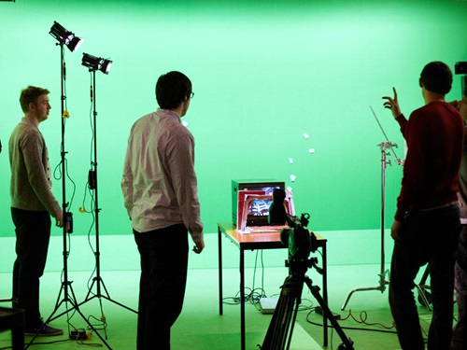
Careers in Media
Managing Procrastination & Productivity

Slide 2
Skills developed in Media
focus & self-discipline
strong verbal communication skills
excellent written communication skills
attention to detail and accuracy
the ability to work independently and flexibly
the ability to work as part of a team
organisational skills
the ability to work well under pressure and meet deadlines
the capacity to prioritise and work across multiple projects
excellent IT skills
Notes:
Source: www.prospects.ac.uk

Slide 3
Examples of careers related to Media
Jobs directly related to your subject include:
Media planner
Media researcher
Film/video games editor
Web content manager
Sound technician, broadcasting / film / video
Music / TV / Film producer
Jobs where your subject would be useful include:
Marketing & advertising executive
Social media manager
Sound designer
Communications engineer
Advertising/digital copywriter
Event manager
Market researcher
Notes:
Source: https://www.prospects.ac.uk/careers-advice/what-can-i-do-with-my-degree/media-studies

Slide 4
Labour Market Information
Media studies graduates typically enter careers in the media, cultural and creative industries. The top jobs held by media studies graduates are marketing associate professionals, sales and retail assistants, arts officers, producers and directors, photographers and broadcasting equipment operators.
Places where you can work- Communications agencies, the Civil Service, colleges and universities, local government, marketing organisations & media companies, publishing companies, TV and radio companies.
Notes:
Source:. https://discovercreative.careers/students-and-parents/are-there-any-proper-jobs/
There are an amazing range of jobs in the media industry, so it's worth checking out where your strengths lie before you narrow down the options.

Slide 5
Examples of Higher Education courses related to the Media
Communication and Media
Creative Advertising
Broadcast Media Technologies
Film & Screen Media
Journalism and Content Creation with Foundation Year in Journalism Studies
Media, Moving Image and Photography
Film and Media Production
Notes:
All on ucas.com, please check individual entry requirements.

Slide 6
Examples of Higher Education courses related to Media
Communication and Media - University of Leeds
Typical A-level offer AAB
Creative Advertising - Leeds Arts University
112 UCAS points from any combination of A Levels / T Level / Extended Diploma / Foundation Diploma. One qualification should be in a relevant subject; or BBC from three A Levels
Film and TV Production - Sheffield Hallam University
112 UCAS points – BBC at A-level with a C in a relevant subject. DMM in BTEC Extended Diploma
Media, Moving Image and Photography – University Centre Rotherham
64 UCAS tariff points – equivalent to DDE grades
Journalism with Foundation Year - Leeds Trinity University
32 UCAS tariff points – equivalent to EE grades from 2 subjects
Notes:
All on ucas.com, please check individual entry requirements.

Slide 7
Where to get further information
https://ccskills.org.uk/careers/advice
https://discovercreative.careers/#/
www.icould.com
www.nationalcareersservice.direct.gov.uk
www.prospects.ac.uk
www.ucas.com
www.discoveruni.org.uk
Notes:
https://www.screenskills.com/
https://icould.com/explore/categories/career-paths/career-ideas-job-profiles-and-subjects/getting-started
https://www.prospects.ac.uk/careers-advice/what-can-i-do-with-my-degree/media-studies

Slide 8
We hope you’ve found this information helpful.
We’d like to hear from you, find us at www.heppsy.org to ask us a question or chat with a HeppSY adviser now at www.heppsy.org/chat
@HeppSYPlus
@HeppSouthYorkshire
facebook.com/HeppSouthYorkshire

